Slide 1
Effect of finerenone on cardiovascular outcomes in patients with chronic kidney disease and type 2 diabetes: results of the
FIGARO-DKD trial
Bertram Pitt
Gerasimos Filippatos, Rajiv Agarwal,
Stefan D. Anker, George L. Bakris, Peter Rossing,
Amer Joseph, Peter Kolkhof, Christina Nowack,
Patrick Schloemer and Luis M. Ruilope, on
behalf of the FIGARO‑DKD investigators
28 August 2021
MA-M_FIN-ALL-0448-1

Slide 2
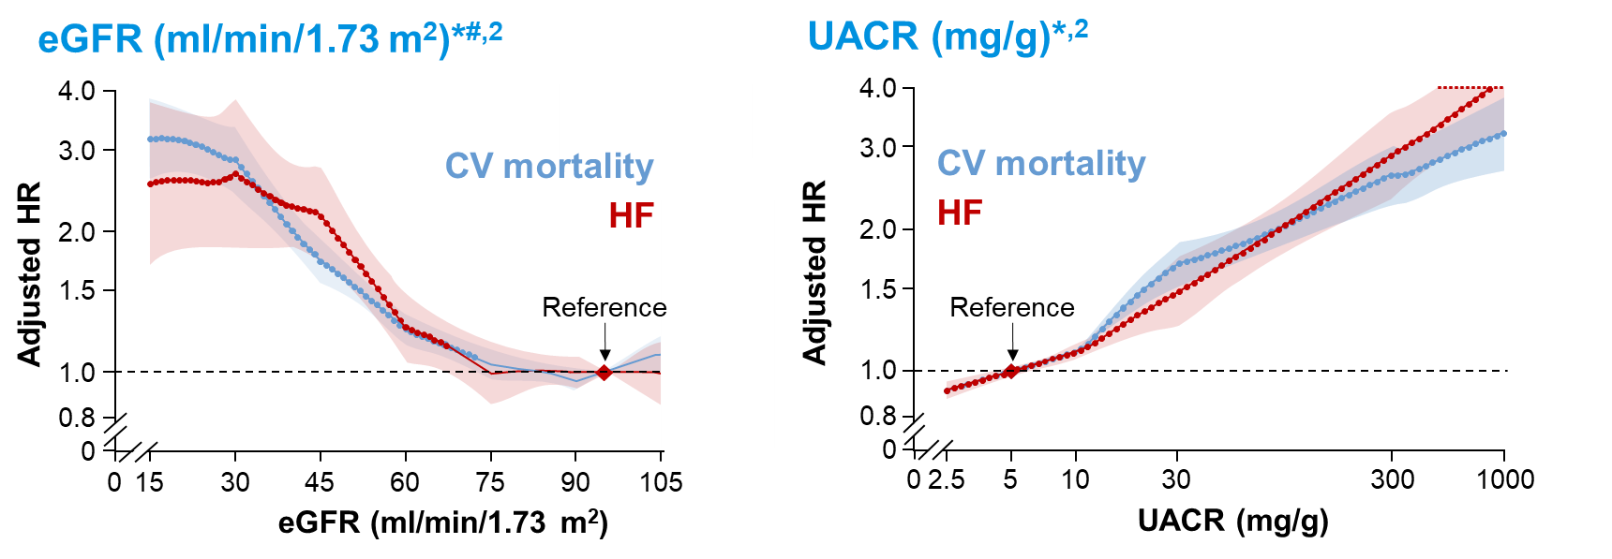
Patients with CKD and T2D have a high risk of hospitalisation for HF and CV death
CV risk increases as eGFR falls below ~75 ml/min/1.73 m² and UACR exceeds 5 mg/g¹
  Diabetes further exacerbates this risk²

Slide 3
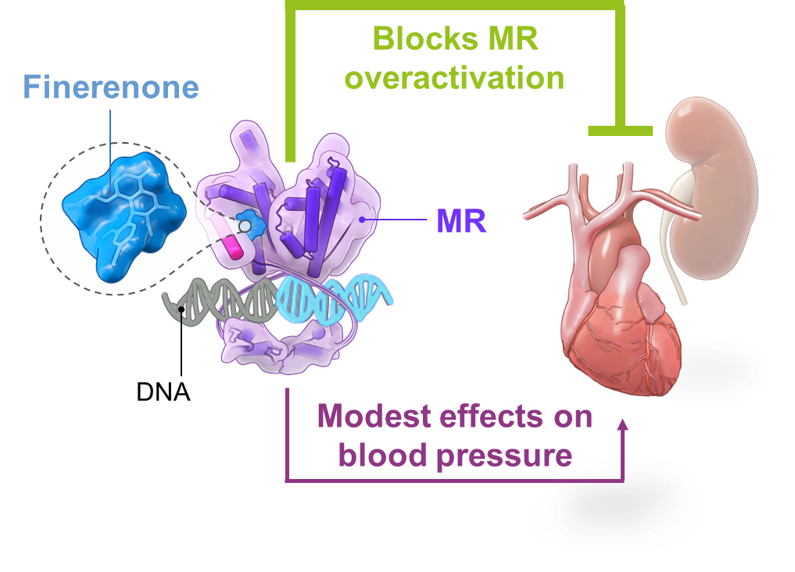
Finerenone is a selective nonsteroidal MRA that interacts with the MR in a different way to steroidal MRAs
Finerenone blocks MR overactivation, which contributes to inflammation and fibrosis, leading to kidney and CV damage^{1,2}
Finerenone has a binding mechanism and distribution which is different from steroidal MRAs, which results in high potency, selectivity and a differential effect on MR cofactor binding^{1,2}
In FIDELIO-DKD, finerenone slowed CKD progression and improved CV outcomes in patients with CKD and T2D³
  The incidence of hyperkalaemia leading to permanent discontinuation was low

Slide 4

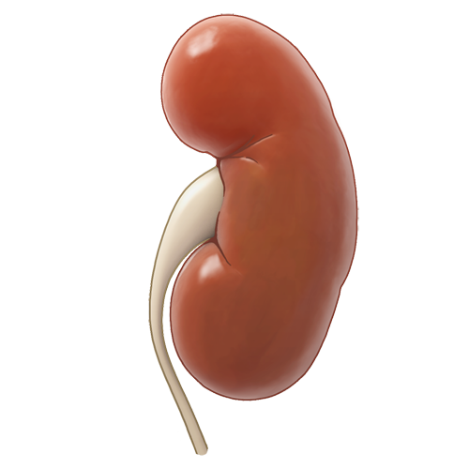

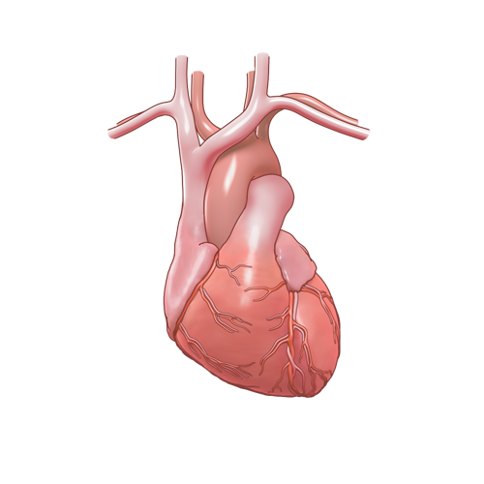
FIGARO-DKD is the second phase III trial in the finerenone clinical programme
FIDELIO-DKD²
Primary outcome: Kidney composite
Finerenone significantly slowed CKD progression by 18% vs placebo in patients with advanced CKD in T2D, irrespective of baseline use of
SGLT-2is and GLP-1RAs
Albuminuria categories¹ (mg albumin/g creatinine)
A1 Normal to mildly increased | A2 Moderately increased | A3 Severely increased
0–29 | 30–299 | ≥300–≤5000
GFR categories (ml/min/1.73 m²) | G1 | ≥90
 | G2 | 60–89
 | G3a | 45–59
 | G3b | 30–44
 | G4 | 15–29
 | G5 | <15
FIGARO-DKD³
Primary outcome: CV composite
Hypothesis: Finerenone reduces
CV morbidity and mortality, and expands the evidence base to cover a broader CKD in T2D population
FIDELIO-DKD
FIGARO-DKD
Overlapping population

Slide 5


FIGARO-DKD study design
19,381 patients enrolled
7437 patients
randomised
3.4 years’ median
follow-up
R
Finerenone 10 or 20 mg od*
Run-in (4–16 weeks)
Screening
Placebo
Key inclusion criteria
Key exclusion criteria
Key ‘time-to-event’ outcomes
Primary CV composite
Aged ≥18 years with T2D
CV death, non-fatal MI, non-fatal stroke, or HHF
eGFR ≥25# ml/min/1.73 m²
HFrEF
with NYHA
Class II–IV
≥40% eGFR kidney composite
UACR ≥30–≤5000 mg/g
≥57% eGFR kidney composite
On maximum tolerated dose of RAS inhibitor for ≥4 weeks
Uncontrolled arterial hypertension‡
Kidney failure,§ sustained ≥40% or ≥57% decrease in eGFR from baseline, or renal death
Serum [K⁺] ≤4.8 mmol/l

Slide 6
Patients had well-controlled blood pressure and HbA1c at baseline and were on optimised CV medications
Characteristic* | Total (n=7352)
Age, years | 64
Male, % | 69
Duration of T2D, years | 14.5
HbA1c, % | 7.7
SBP/DBP, mmHg | 136/77
History of CV disease, % | 45
History of HF, % | 7.8
Medications, % | Total (n=7352)
CV medications RASi Statins Beta-blockers Calcium antagonists Diuretics | 7343 (100) 5184 (71) 3536 (48) 3773 (51) 3496 (48)
Glucose-lowering therapies Metformin Insulin GLP-1RAs SGLT-2i | 7196 (98) 5067 (69) 3993 (54) 550 (7.5) 618 (8.4)

Slide 7
62% of patients had albuminuric CKD with preserved kidney function (eGFR ≥60 ml/min/1.73 m²)
eGFR at baseline (ml/min/1.73 m²)*
UACR is an important indicator for kidney damage¹
Median UACR = 308 mg/g
Patients with eGFR
≥60 ml/min/1.73 m² had
albuminuric CKD
with a UACR ≥30 mg/g
Mean eGFR:
68 ml/min/1.73 m²

Slide 8
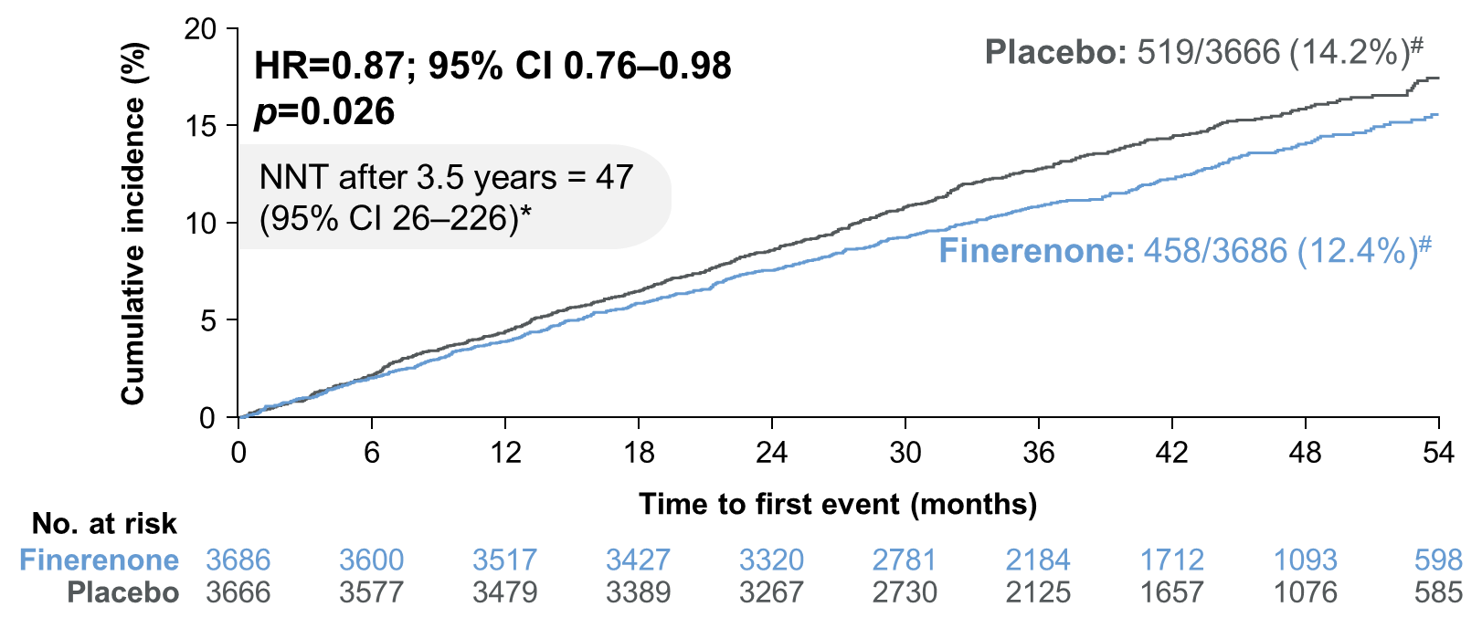
On top of optimised RAS blockade, finerenone significantly reduced the risk of the primary CV outcome by 13% vs placebo
Time to CV death, non-fatal MI, non-fatal stroke, or HHF
8

Slide 9
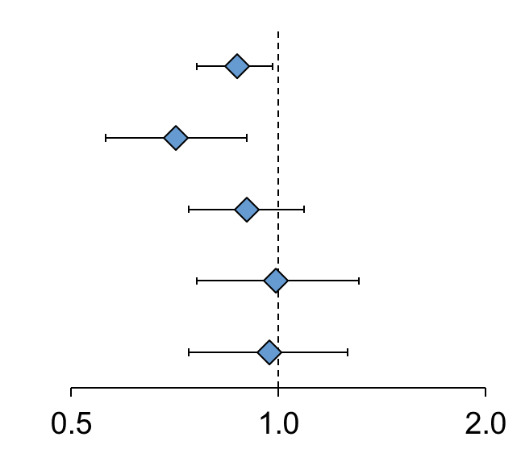
The CV benefit of finerenone was primarily driven by a reduction in HHF, despite exclusion of patients with symptomatic HFrEF
Outcome | Finerenone (n=3686) | Placebo (n=3666) | Hazard ratio (95% CI) |  | p-value*
 | n (%) | n (%)
Primary outcome# | 458 (12.4) | 519 (14.2) |  | 0.87 (0.76–0.98) | 0.026
HHF | 117 (3.2) | 163 (4.4) |  | 0.71 (0.56–0.90) | 0.004
CV death | 194 (5.3) | 214 (5.8) |  | 0.90 (0.74–1.09) | 0.274
Non-fatal MI | 103 (2.8) | 102 (2.8) |  | 0.99 (0.76–1.31) | 0.963
Non-fatal stroke | 108 (2.9) | 111 (3.0) |  | 0.97 (0.74–1.26) | 0.793
Favours finerenone
Favours placebo
9

Slide 10
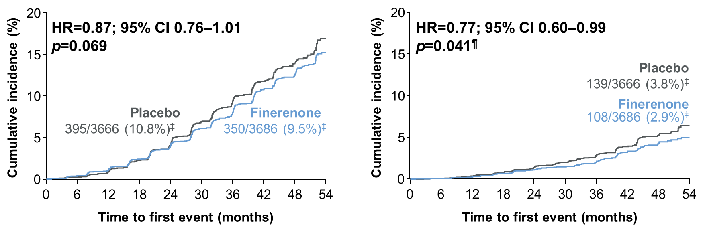

Finerenone did not significantly reduce the ≥40% eGFR kidney outcome, but trended to improve the clinically accepted ≥57% eGFR kidney outcome
Kidney failure,* sustained ≥40% decrease
in eGFR from baseline, or renal death#
Kidney failure, sustained ≥57% decrease
in eGFR from baseline,§ or renal death#
ESKD occurred in 0.9% vs 1.3% of finerenone vs placebo recipients
(HR=0.64; 95% CI 0.41–0.995; p=0.046¶)

Slide 11
The overall incidence of treatment-emergent adverse events was similar between the finerenone and placebo groups
Treatment-emergent AE, n (%) | Finerenone (n=3683) | Placebo (n=3658)
Any AE | 3134 (85.1) | 3129 (85.5)
AE related to study drug | 560 (15.2) | 413 (11.3)
AE leading to treatment discontinuation | 207 (5.6) | 183 (5.0)
Any serious AE | 1158 (31.4) | 1215 (33.2)
Serious AE related to study drug | 35 (1.0) | 27 (0.7)
Serious AE leading to treatment discontinuation | 70 (1.9) | 76 (2.1)
AE with outcome death | 79 (2.1) | 100 (2.7)

Slide 12
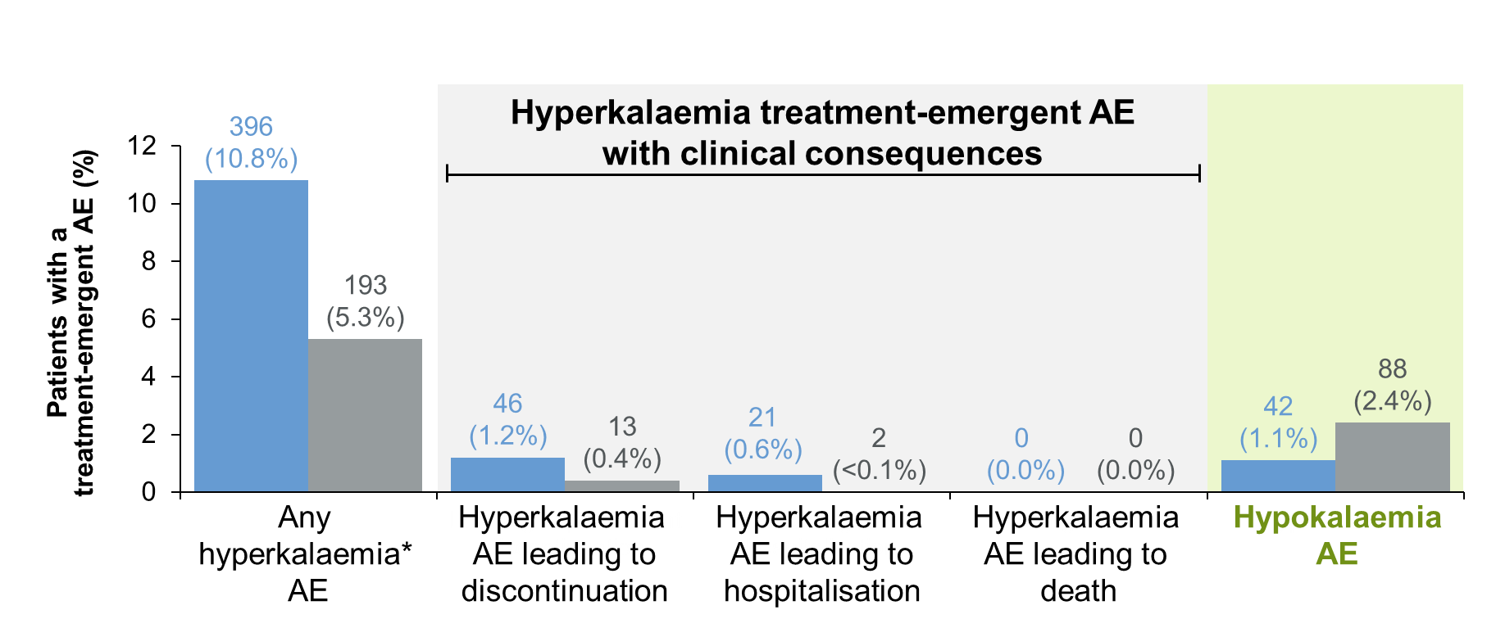
Effect of finerenone on hyperkalaemia and hypokalaemia versus placebo
Finerenone (n=3683)
Investigator-reported treatment-emergent AEs
Placebo (n=3658)

Slide 13


Other effects of finerenone were consistent with its mechanism of action
Finerenone is highly selective for the MR:
there were no ‘off-target’ sexual side effects associated with finerenone treatment
Hypertension occurred in fewer patients on finerenone than placebo (5.6% vs 8.4%)
Hypotension occurred in more patients on finerenone than placebo (4.2% vs 2.5%),
but discontinuation due to hypotension was uncommon (<0.1% vs 0.0%)
Finerenone had a modest effect on SBP
Overall LS mean difference
(finerenone vs placebo):
–2.71 mmHg
Finerenone had no effect
on HbA1c
Overall LS mean difference
(finerenone vs placebo):
0.03%
Notes:
Speaker notes:
Finerenone is highly selective for the MR - and we saw no 'off target' sexual side effects
The MR plays a role in BP homeostasis - finerenone had a modest effect on BP, and fewer patients had hypertension AEs and more patients had hypotension AEs. However, discontinuation due to hypotension was uncommon.
The MR does not play a part in blood glucose regulation.
Finerenone had no effect on HbA1c

Slide 14


FIGARO-DKD summary
In patients with CKD stage 1–4 with moderate-to-severely elevated albuminuria (UACR ≥30 mg/g), well-controlled SBP and HbA1c, treated with optimised RAS blockade, finerenone:
Significantly reduced the risk of CV morbidity and mortality by 13%
The benefit of finerenone was driven by a reduction in HHF despite the
exclusion of patients with HFrEF
Had a favourable trend on kidney outcomes
Although finerenone had a non-significant effect on the ≥40% eGFR
composite outcome, exploratory findings show that finerenone significantly
reduced the incidence of ESKD and the ≥57% eGFR composite outcome
Was associated with a similar incidence of AEs to placebo
Low incidence permanent discontinuation due to hyperkalaemia (1.2% vs 0.4%)

Slide 15
Conclusion
The results of FIGARO-DKD highlight:
The need for early CKD treatment to reduce the CV and HF burden in this patient population
The importance of UACR monitoring in patients with T2D and an eGFR ≥60 ml/min/1.73 m²
Together, the results of FIGARO-DKD and FIDELIO‑DKD¹ suggest finerenone provides kidney and CV benefits across the spectrum of patients with CKD and T2D

Slide 16
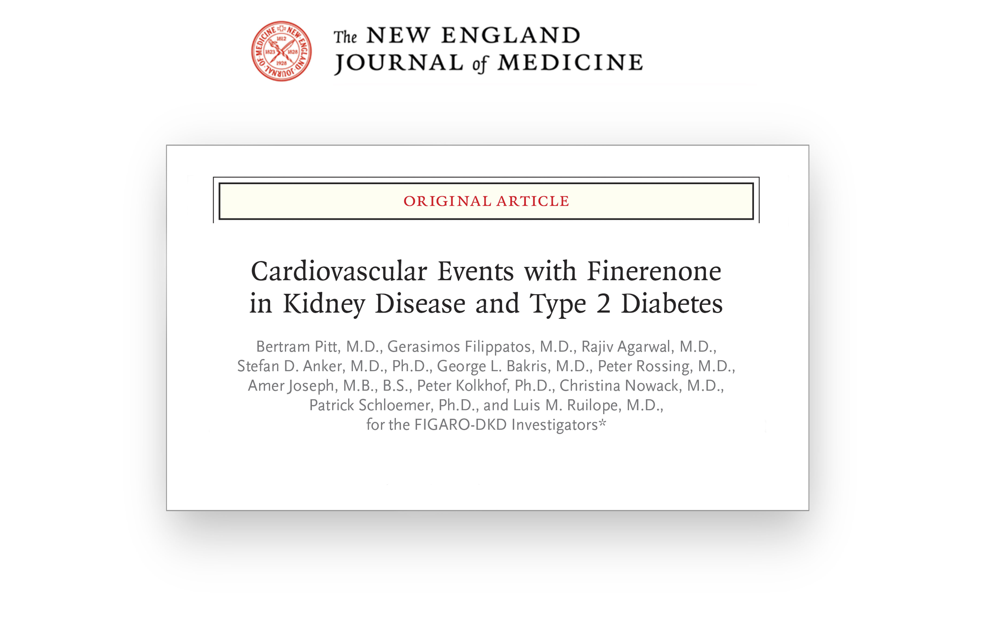
Results from the FIGARO-DKD trial are now available in:

Slide 17

Thank you
48 countries, 19,381 patients enrolled, 7437 patients randomised
Executive committee
George L. Bakris; Gerasimos Filippatos; Rajiv Agarwal; Stefan D. Anker; Luis M. Ruilope; Bertram Pitt
Independent data monitoring committee
Murray Epstein; Aldo Maggioni; Glenn Chertow; Gerald DiBona; Tim Friede; Jose Lopez-Sendon; Jean Rouleau
Clinical event committee
Rajiv Agarwal; Stefan Anker; Phyllis August; Andrew Coats; Hans Diener; Wolfram Döhner; Barry Greenberg;
Stephan von Haehling; James Januzzi; Alan Jardine; Carlos Kase; Sankar Navaneethan; Lauren Phillips;
Piotr Ponikowski; Pantelis Sarafidis; Titte Srinivas; Turgut Tatlisumak; John Teerlink
National lead investigators
Augusto Vallejos; Richard MacIsaac; Guntram Schernthaner; Pieter Gillard; Maria Eugenia F. Canziani; Theodora Temelkova‑Kurktschiev;
Ellen Burgess and Sheldon Tobe; Fernando González; Zhi-Hong Liu; Andrés Ángelo Cadena Bonfanti and Carlos Francisco Jaramillo;
Martin Prazny; Peter Rossing; Jorma Strand; Michel Marre; Roland Schmieder and Christoph Wanner; Pantelis A. Sarafidis; Juliana Chan;
László Rosivall; Joseph Eustace; Ehud Grossman and Yoram Yagil; Giuseppe Remuzzi; Daisuke Koya and Takashi Wada;
Luis Alejandro Nevarez Ruiz; Ron Gansevoort and Adriaan Kooy; Trine Finnes; Froilan De Leon; Janusz Gumprecht;
Fernando Teixeira e Costa; Alexander Dreval; Anantharaman Vathsala; Aslam Amod; Sin Gon Kim and Byung Wan Lee;
Julio Pascual Santos; Bengt-Olov Tengmark; Michel Burnier; Chien-Te Lee; Sukit Yamwong; Ramazan Sari; Kieran McCafferty;
Borys Mankovsky; Sharon Adler, Linda Fried, Robert Toto, and Mark Williams; Tran Quang Khanh
The FIGARO-DKD team would also like to thank all participating investigators, the centres, the patients and their families

Slide 18
Central laboratory assessments
Treatment-emergent adverse events, n (%) | Finerenone (n=3683) | Placebo (n=3658)
Treatment-emergent serum potassium >5.5 mmol/l | 495 (13.5) | 233 (6.4)
Treatment-emergent serum potassium >6.0 mmol/l | 86 (2.3) | 43 (1.2)

